Slide 1
How an Idea Became a Team: The First Year with Team Dolly
Betty Adams, Stefanie Caloia, Nina Fawaz, Megan Hakala, Lori Rinaldi, Sarah Sorensen

Slide 2
Inception of Dolly Parton's Imagination Library Team
Graduate student while pregnant
Dean Cawthorne's Brown Bag Luncheon
LVST
#TeamDolly

Slide 3
How Do Plan???

Slide 4
Time management and timeline planning
HOW?
Plans A, B, C, & D
(Stephanie Masters presentation): Make a plan, knowing that your plan will most likely be derailed by something...COVID
A-Team, coordination, role division

Slide 5
Wayne State Warriors
LVST Tuesday – Betty presented the idea, and the team was born!
Jill Wurm
501c3 = WSU Foundation; Susan Burns
Jim Dauer
Courtney Durham, WSU Giving Day/Warrior Funder
Sarah Sorensen (GSA Project, headed by Katrina Rouan)
Nina Fawaz – new Team Dolly member!
Jennifer Gustafson—Detroit Literacy Project
Mike Priehs & Stephanie Masters—future planning, support, goal focus

Slide 6
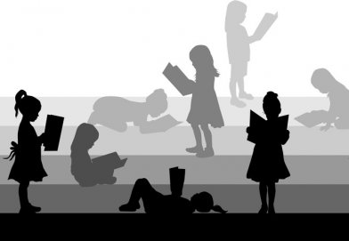
Community
Brilliant Detroit
313 Reads
United Way for Southeastern Michigan
Head Start Wayne Metropolitan Community Action Agency
Detroit Literacy Project
Orchard Children's Services

Slide 7
Other DPIL Programs to Learn From
United Way for Southeastern Michigan
West Virginia
Ohio

Slide 9
http://www.governorsfoundation.org/
Brandie Turner
Early Literacy Specialist
WV's Imagination Library Fundraising Coordinator
Marshall University
College of Education - June Harless Center

Slide 10
Kristy Amy, Director of Community Outreach
Ohio Governor's Imagination Library
4/10/2020 Microsoft Teams meeting
State-wide program initiated by Ohio’s First Lady DeWine in 2019
Every OH child; 88 counties by 2021
Cincinnati Children’s Hospital research—2019 study found that children who participated in Imagination Library saw an average increase of 15.4% in their Kindergarten Readiness Assessment (INNOVATIONS, 2019)
Professional fundraisers—tips and tricks (GRASSROOTS)

Slide 11
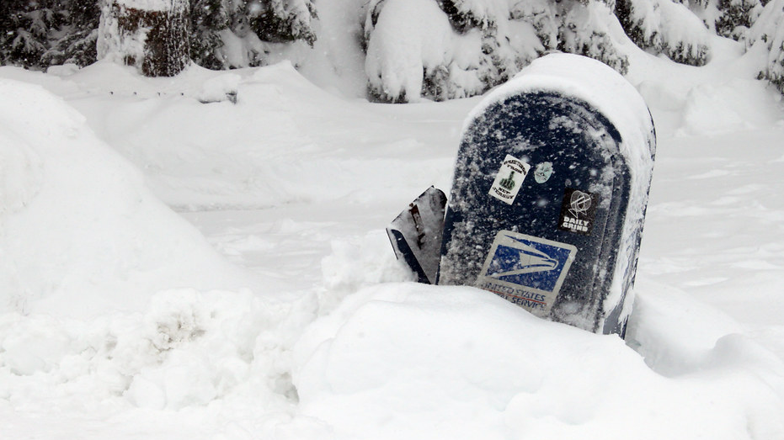
The United States Post Office DON'Ts
What didn't work??
Communications, structure within another large organization
Running in circles
Overloaded with policies
Confirmation from Ohio's Imagination Library—work from the ground up
Know WHEN to bring ideas to the top, when the right parties are going to be involved in the discussion...is there a best person to introduce this idea?
Who you know
Lessons in GRASSROOTS connections

Slide 12
The United States Post Office DO's
Call up each local Post office individually and ask to speak with a MANAGER.
GRAND RIVER- Did not get a name. Answer?
GRATIOT- Spoke to Darryl. Answer?
DETROIT ( FORT STREET)- Never got a hold of anyone. Answer?
NORTH END- Spoke to Todd. Answer?
This Photo by Unknown author is licensed under CC BY-SA.

Slide 13
Fundraising
WarriorFunder – LVST matching
CARES Relief Fund
COVID hurdles

Slide 14
Ongoing Projects
Orchard Children's Services
United Way (Ready4K)
Children's book authors
Database management

Slide 15
Program Launch!
Read-a-thon rebrand.ly/wsudpil
Opening up registration https://imaginationlibrary.com/check-availability/?#selectedCountry=US
WarriorFunder https://warriorfunder.wayne.edu/dolly

Slide 16
Next steps
Nina's hot political connections
Expanding program for WSU community
Perpetual fundraising

Slide 17
Questions?

Slide 18
Thank you!

