Slide 1
Research workflows for iPad 📱
EndNote and Zotero
Alexandra Sarkozy, MSI
July 21, 2015

Slide 2
EndNote and Zotero
Bibliographic management software
Formerly desktop applications, now web-enabled
Standalone iPad apps: EndNote, Papership, Zotpad
Store citations and PDFs, annotations, and other attachments

Slide 3
EndNote for iPad

Slide 4
EndNote for iPad 📱
WSU site license includes desktop and cloud access to EndNote library
iPad app is separate, 💰
Sync library across devices
Sync annotations across machines and devices
No Word integration for iPad app (yet) 📝
No proxy integration 😔

Slide 5
EndNote for iPad
Create account at myendnoteweb.com
Sync with desktop library (only one library can be synced; 4 gig storage)
Download iPad app
Login and sync library

Slide 6
EndNote for iPad
You can:
Add references to library from web or from library databases
Add PDFs from open sources or where proxy access through browser is available
View and annotate citations and PDFs
Share citations and PDFs with colleagues via messaging and email
Manage groups and organize citations

Slide 7
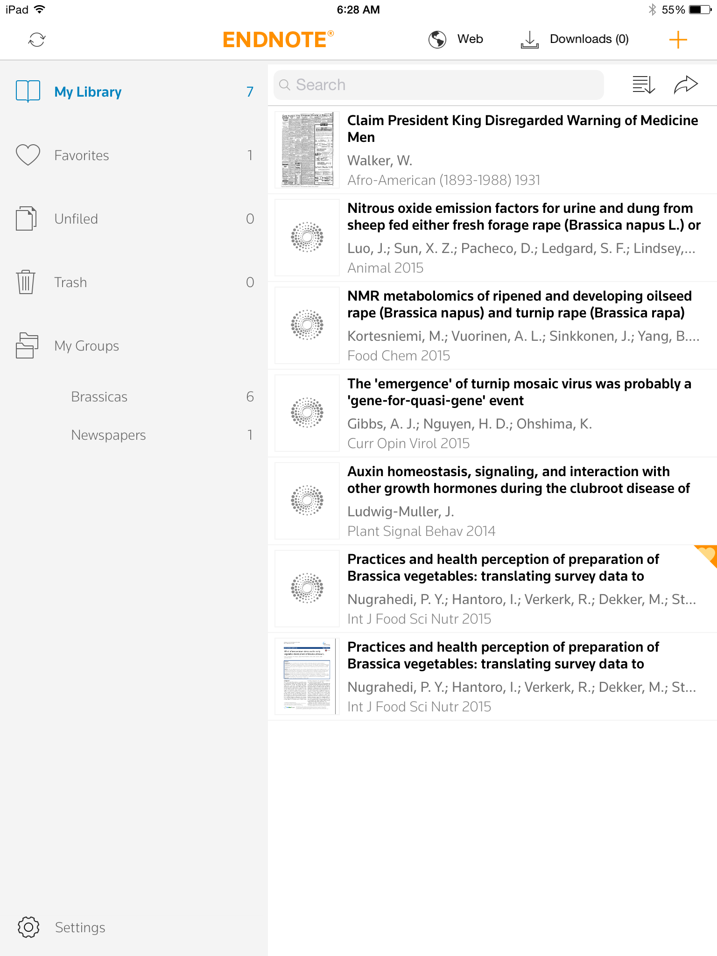
EndNote for iPad
Let's take a look:

Slide 8
Workflow for adding references
Adding a citation from a database
Navigate to library website from within EndNote browser
Choose database, search, locate citation
Export citation as usual
Open PDF if accessible
"Open in…" EndNote for iPad
Download citation from Downloads folder
Drag and drop PDF from Downloads folder to attach to citation record

Slide 9
Zotero For iPad

Slide 10
Zotero for iPad
Two apps: Papership and Zotpad
Papership can also be a client for Mendeley library
Mostly read-only, i.e., "PDFs on the beach" 🌴
Papership can extract DOI from certain newer PDFs and pull citation from Google Scholar

Slide 11
Zotero for iPad
Create Zotero account at www.zotero.org
Install Zotpad and/or Papership
Login and sync with Zotero account
No proxy capability, though you can set a proxy in desktop Zotero Firefox plugin or standalone version

Slide 12
Workflow for Papership
Open Safari and navigate to PDF, either through web or library databases
In PDF reader, choose "Open in…" Papership
Same for Zotpad: "Open in…" Zotpad
Papership might generate a proper citation; otherwise only PDF is imported

Slide 13
Papership and Zotpad Preview

Slide 14
Danke schön!
🌻🌾🍄🐅🐇🐆🐏🐓🐛🍫

