Slide 1
What’s To Fear?!? Owning the Mistakes We Make and Learning from Them
Damecia Donahue | Mike Hawthorne | Mike Priehs
Wayne State University Library System
2014 Michigan Library Association Annual Conference | October 15 – 17, 2014 | Grand Rapids, MI

Slide 2
The Plan
Team Learning from Mistakes
Complacency (Inattentive)
Errors of Omission / Commission
Group Discussion / Sharing
2014 Michigan Library Association Annual Conference | October 15 – 17, 2014 | Grand Rapids, MI

Slide 3
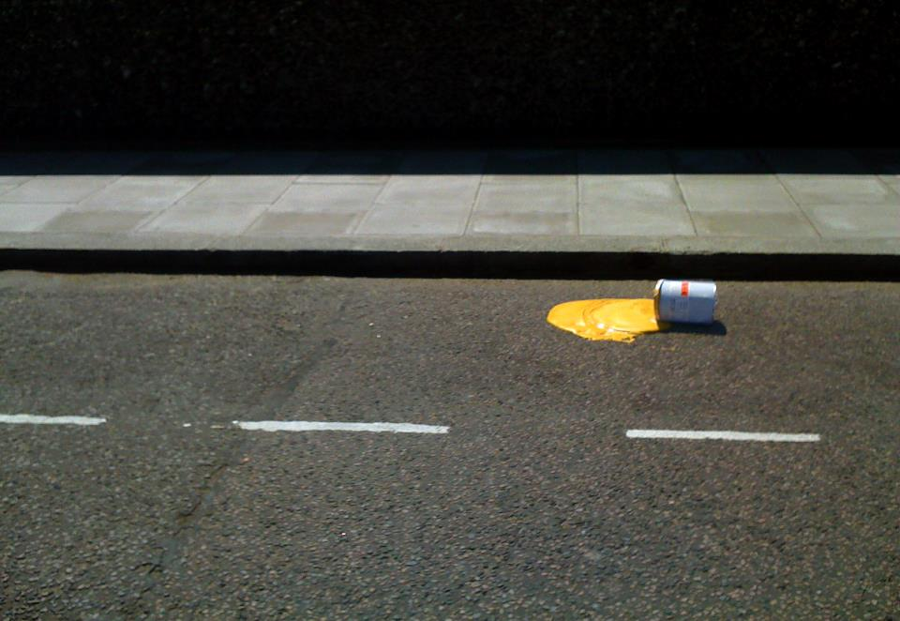
What’s a Mistake?
"a wrong action or statement proceeding from faulty judgment, inadequate knowledge, or inattention."
From http://www.merriam-webster.com/dictionary/mistake
https://www.flickr.com/photos/beansandgrapes/4767515505/
2014 Michigan Library Association Annual Conference | October 15 – 17, 2014 | Grand Rapids, MI

Slide 4
But First…
A mistake from
Randy Dykhuis
Executive Director at Midwest Collaborative for Library Services
2014 Michigan Library Association Annual Conference | October 15 – 17, 2014 | Grand Rapids, MI

Slide 5
Sometimes
even I
make mistakes
2014 Michigan Library Association Annual Conference | October 15 – 17, 2014 | Grand Rapids, MI

Slide 6
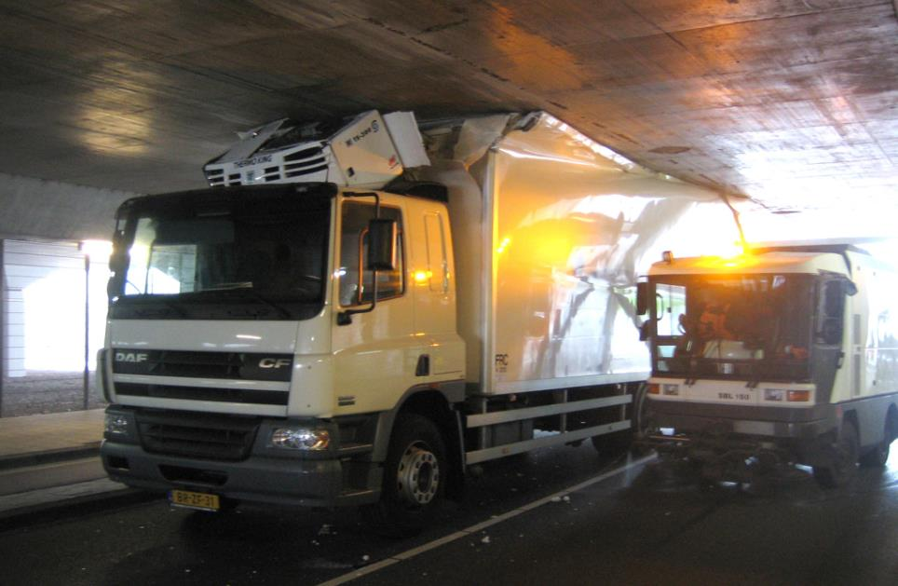
Team Learning from Mistakes
https://www.flickr.com/photos/p8/217519226/
2014 Michigan Library Association Annual Conference | October 15 – 17, 2014 | Grand Rapids, MI

Slide 7
Team Learning from Mistakes
Blaming Approach
vs.
Problem Solving Approach
https://www.flickr.com/photos/indyplanets/3926147797/
2014 Michigan Library Association Annual Conference | October 15 – 17, 2014 | Grand Rapids, MI

Slide 8
Team Learning from Mistakes
Cooperative Goals
vs.
Competitive Goals
https://www.flickr.com/photos/indyplanets/3926147797/
2014 Michigan Library Association Annual Conference | October 15 – 17, 2014 | Grand Rapids, MI

Slide 9
Testing the Hypothesis
(Tjosvold, 2004)
A blaming approach reduces team learning from mistakes
A problem solving approach promotes team learning from mistakes
Cooperative goals facilitate team problem solving
Competitive goals induce blaming within teams
https://www.flickr.com/photos/indyplanets/3926147797/
2014 Michigan Library Association Annual Conference | October 15 – 17, 2014 | Grand Rapids, MI

Slide 10
Testing the Hypothesis
(Tjosvold, 2004)
A blaming approach reduces team learning from mistakes
A problem solving approach promotes team learning from mistakes
Cooperative goals facilitate team problem solving
Competitive goals induce blaming within teams
https://www.flickr.com/photos/indyplanets/3926147797/
2014 Michigan Library Association Annual Conference | October 15 – 17, 2014 | Grand Rapids, MI

Slide 11
Complacency (Inattentive)
https://www.flickr.com/photos/indyplanets/3926147797/
2014 Michigan Library Association Annual Conference | October 15 – 17, 2014 | Grand Rapids, MI

Slide 12
Complacency (Inattentive)
Definition:
Self-satisfaction especially when
accompanied by unawareness of
actual dangers or deficiencies
An instance of usually unaware or
uninformed self-satisfaction
Merriam-Webster Online Dictionary
http://www.merriam-webster.com/dictionary/complacency retrieved 10/11/2014
2014 Michigan Library Association Annual Conference | October 15 – 17, 2014 | Grand Rapids, MI

Slide 13
Impact
Limits self-awareness
Blocks critical thinking & opportunities for process improvements
Limits opportunities for change - new ideas
https://www.flickr.com/photos/indyplanets/3926147797/
2014 Michigan Library Association Annual Conference | October 15 – 17, 2014 | Grand Rapids, MI

Slide 14
Wayne State University - Safety Net
Library Monitors - Retired Detroit Police Officers (avg. 30 years)
Security cameras – 35 cameras
Wayne State University Public Safety Department – 60 Officers
Security cameras-campus exterior
Policies/Practices
Review camera footage ONLY in the event of patron initiated request-typically if there was a theft of personal items
My “WTF!” Moment
WSU Law School Student last seen in Undergraduate library
Outcome
Software program that “ping” hard drive on regular basis to verify in working condition – update/addition of all cameras
Turned day-to-day managing of cameras over to qualified person
Upgraded/Added HD Cameras
https://www.flickr.com/photos/indyplanets/3926147797/
2014 Michigan Library Association Annual Conference | October 15 – 17, 2014 | Grand Rapids, MI

Slide 15
Ways to Counter Complacency
In areas NOT your expertise develop resources (people , tools, policies, etc…) that will help you minimize risks
Have policy/procedures in place to regularly evaluate current processes
DO NOT fear making mistakes – it’s a good way to learn – fear can lead to paralysis
DO NOT be afraid to give up control – for the good of all (particularly yourself)
WTF! moments will always happen – but they do not have to be deal breakers
https://www.flickr.com/photos/indyplanets/3926147797/
2014 Michigan Library Association Annual Conference | October 15 – 17, 2014 | Grand Rapids, MI

Slide 16
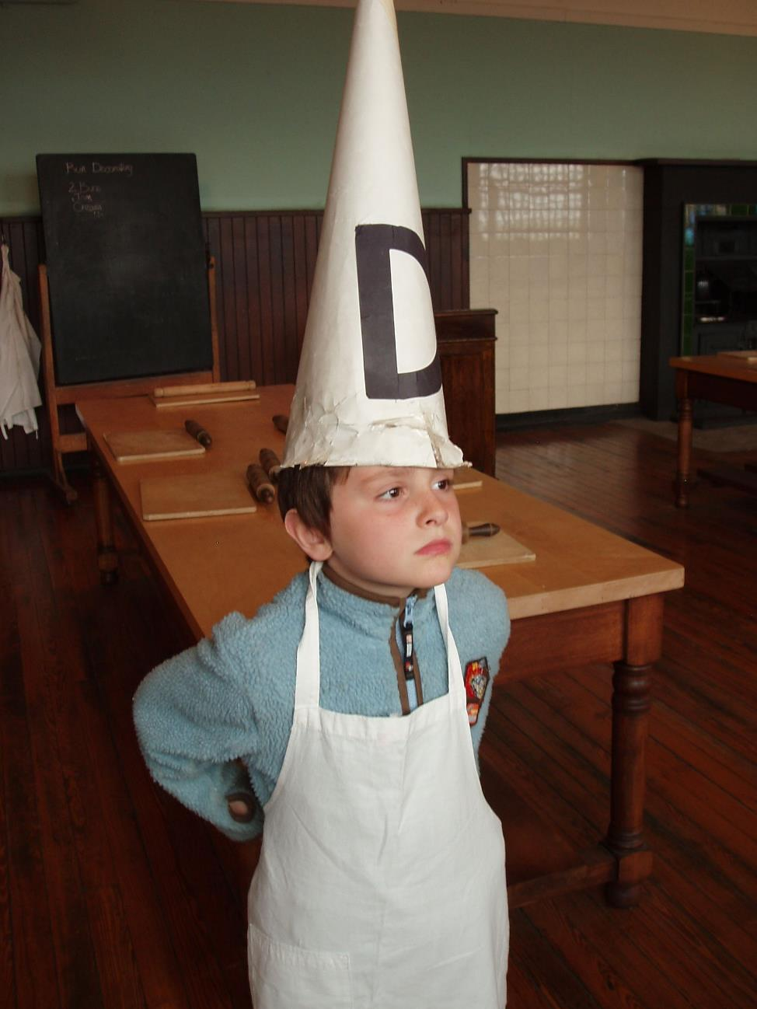
Errors of Commission and Omission
https://www.flickr.com/photos/ilike/537193475/
2014 Michigan Library Association Annual Conference | October 15 – 17, 2014 | Grand Rapids, MI
Notes:
Error of commission: doing something that should not have been done
Error of omission: not doing something that should have been done
When we make any decisions about doing pretty much anything, we all more than likely perform one of theses errors, or both at the same time
All of the examples we've heard so far hit on both of these (if you blame somebody, you're more than likely trying to conceal your mistake because you did something you shouldn't have; or if you are focused on competitive, or individual goals, you could potentially be thriving on, or motivated by, self-satisfaction which could cause you to do something that should not have been done, incorporating team goals )

Slide 17
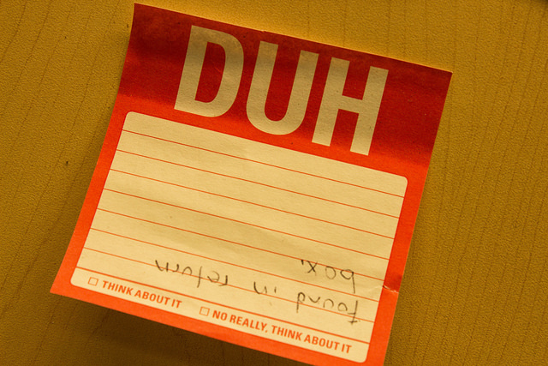
The Devil’s in the Details
https://www.flickr.com/photos/121433567@N03/14233043984/
2014 Michigan Library Association Annual Conference | October 15 – 17, 2014 | Grand Rapids, MI
Notes:
Faulty judgment
Inadequate Knowledge
Inattention and ended up being a group learning mistake (touches on what they discussed)

Slide 18
Confronting Failure
Error/Failure: deviation from expected (and desired) results
Avoidable errors (errors of commission)→implies other options
Unavoidable errors (errors of omission)→implies no escape
Identify
Analyze and discuss
Deliberate experimentation
Handle conflict productively*
https://www.flickr.com/photos/indyplanets/3926147797/
Derived from Mark D. Cannon and Amy C. Edmondson
2014 Michigan Library Association Annual Conference | October 15 – 17, 2014 | Grand Rapids, MI
Notes:
When we commit errors, we are essentially failing at something in some way, big or small, so we can define both simply as deviation from expected and desired results (avoidable errors (commission errors, something that shouldn't have been done in the first place) and unavoidable errors (omission errors, not doing something that should have been done, can't escape it)
All of our examples exemplify both of these (example, I could have asked questions or looked around in the IR for examples; or technological errors are inevitable, no escape, something isn’t going to work at all, or work completely correctly)
Identify: Proactive and timely identification of failure, and the errors involved encourages learning
Opportunities to learn can't happen if mistakes are covered up
Discuss and analyze: Thoughtful analysis and discussion is crucial
Deliberate experimentation: Increasing one's chances at failure by experimenting can help us recognize errors before they can occur. May not have resources to do this, might not be encouraged.
Purpose: to learn and innovate
Handling conflict: Situational; Share differences of perspective without bitter exchanges (likely to occur in discussion stage, be open, positive, and offer constructive criticism, no blaming approach)

Slide 19
Error Management Culture
Common Practices
Potential Effects
https://www.flickr.com/photos/indyplanets/3926147797/
Communicating
Sharing knowledge
Helping
Quick detection and damage control
Analyzing
Coordinating error handling
Effective error handling
Reduced neg. consequences
Learning
Secondary error prevention
Innovation
Initiative, exploration, experimentation
Improved quality of services
Derived from Cathy van Dyck, Michael Frese, Markus Baer, and Sabine Sonnentag
2014 Michigan Library Association Annual Conference | October 15 – 17, 2014 | Grand Rapids, MI
Notes:
With the idea of confronting failure, we are essentially we are trying to create an organizational error management culture:
Organizations that have an effective approach to errors may be more profitable because they learn from errors, more apt to experiment, and more likely to
innovate.
This approach assumes that errors (human and non-human) can NEVER be completely prevented, and therefore, it necessary to ask what can be done after an
error has occurred. Reduce negative consequences and increase positive consequences.
In turn leads to overall (organization) goal attainment; survival; and return on investments

Slide 20
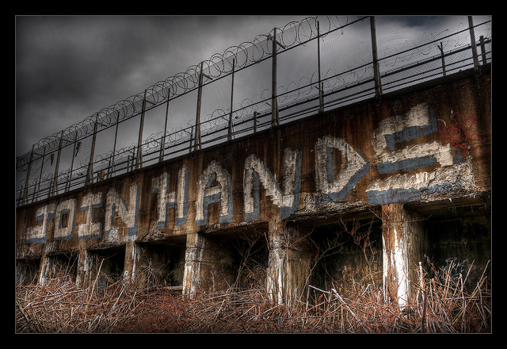
Kumbaya Moment? Not So Fast...
https://www.flickr.com/photos/vogelium/10565496565/
2014 Michigan Library Association Annual Conference | October 15 – 17, 2014 | Grand Rapids, MI
Notes:
Click to add notes

Slide 21
Technical Barriers (embedded in technical systems)
Identifying failures
Small failures can be made ambiguous
Heightened/false sense of confidence that nothing is wrong
Recommendations
Build systems to capture and organize data & ENSURE availability of technical and systems experts
Detection of anomalies
https://www.flickr.com/photos/indyplanets/3926147797/
Derived from Mark D. Cannon and Amy C. Edmondson
2014 Michigan Library Association Annual Conference | October 15 – 17, 2014 | Grand Rapids, MI
Notes:
By using the 3 main ways we can confront failure, (identifying it; discussing and analyzing it; and experimentation) let’s take a look at some barriers.
This can also lead to further problems though if using software or program, can lead to more failures, or missed data analysis

Slide 22
Technical Barriers (embedded in technical systems)
Analyzing/Discussing failures
Lack skills/technique
Jump to questionable conclusions, don’t recognize we lack info, or analysis isn’t complete
Recommendations
Reviews or other formal activities that follow guidelines for effective analysis & ENSURE data analysis knowledge
Extract lessons from failures
https://www.flickr.com/photos/indyplanets/3926147797/
Derived from Mark D. Cannon and Amy C. Edmondson
2014 Michigan Library Association Annual Conference | October 15 – 17, 2014 | Grand Rapids, MI
Notes:
By using the 4 ways we can confront failure, (identifying it; discussing and analyzing it; and experimentation) let’s take a look at some barriers.
Problem here could be that review system or activities could be flawed because you don’t know what to expect and every situation is different

Slide 23
Technical Barriers (embedded in technical systems)
Experimentation
Lack knowledge of experimental design and/or limited availability to isolate variables (reduce ‘noise’)
Inability to consider possible outcomes and how they might be interpreted
Recommendations
Training in-house and consultants
Advisement on pilot projects and other experiments
https://www.flickr.com/photos/indyplanets/3926147797/
Derived from Mark D. Cannon and Amy C. Edmondson
2014 Michigan Library Association Annual Conference | October 15 – 17, 2014 | Grand Rapids, MI
Notes:
By using the 4 ways we can confront failure, (identifying it; discussing and analyzing it; and experimentation) let’s take a look at some barriers.
Might not have $ for consultants or even an in-house expert

Slide 24
Social Barriers (embedded in social systems)
Identifying failures
Threats to self-esteem & ‘shoot the messenger’ culture
Inhibits recognition of one’s own failures & reporting of failures
Recommendations
Psychological safety: blameless reporting systems; open door policies; first line mgmt. training; PUBLICIZE FAILURES! ☺
Learning
https://www.flickr.com/photos/indyplanets/3926147797/
Derived from Mark D. Cannon and Amy C. Edmondson
2014 Michigan Library Association Annual Conference | October 15 – 17, 2014 | Grand Rapids, MI
Notes:
By using the 4 ways we can confront failure, (identifying it; discussing and analyzing it; and experimentation) let’s take a look at some barriers.
Social biggest problem this might not happen: FEAR! Also, people may be unaware that there are psychological safety systems in place.

Slide 25
Social Barriers (embedded in social systems)
Analyzing/Discussing failures
Ineffective group process
Limits effectiveness of analysis
Recommendations
Availability of people with group dialogue and collaborative learning experience (outside hire) & (in-house) invest development of these skills
Insight from diverse perspectives
https://www.flickr.com/photos/indyplanets/3926147797/
Derived from Mark D. Cannon and Amy C. Edmondson
2014 Michigan Library Association Annual Conference | October 15 – 17, 2014 | Grand Rapids, MI
Notes:
By using the 4 ways we can confront failure, (identifying it; discussing and analyzing it; and experimentation) let’s take a look at some barriers.
Ineffective group process: maybe one of the people you collaborated with has individual goals in mind instead of group goals, they just want to come up with a solution on their own to be the hero
Issue: no $, time, may have managers who don’t have time to take on another layer of job duties, etc.

Slide 26
Social Barriers (embedded in social systems)
Experimentation
Organization penalizes failed experiments
Inhibits willingness to incur failure for sake of learning
Recommendations
Choose key operations with which to experiment; publicize results + & -
Innovation, lead by example
https://www.flickr.com/photos/indyplanets/3926147797/
Derived from Mark D. Cannon and Amy C. Edmondson
2014 Michigan Library Association Annual Conference | October 15 – 17, 2014 | Grand Rapids, MI
Notes:
By using the 4 ways we can confront failure, (identifying it; discussing and analyzing it; and experimentation) let’s take a look at some barriers.
Issue: might not be able to, or feel comfortable with experimentation, assumes you work in an environment where experimentation is encouraged

Slide 27
Activity
Fear
Negative consequences
Embarrassment
Feel stress when admitting/making mistake
Concern for what errors might occur
Advantages for covering up errors
Why admit when no one will find out
No point in discussing errors with others
Admitting is asking for trouble
Harmful to make errors known to others
https://www.flickr.com/photos/indyplanets/3926147797/
2014 Michigan Library Association Annual Conference | October 15 – 17, 2014 | Grand Rapids, MI

Slide 28
Works of Interest
Cannon, Mark D., and Edmondson, Amy C. "Confronting Failure: Antecedents and Consequences of Shared Beliefs About Failure in Organizational Work Groups". Journal of Organizational Behavior 22 (2001): 161-177.
Cannon, Mark D., and Edmondson, Amy C. "Failing to Learn and Learning to Fail (Intelligently): How Great Organizations Put Failure to Work to Innovate and Improve". Long Range Planning 38 (2005): 299-319.
van Dyck, Cathy, Frese Michael, Baer, Markus, and Sonnentag, Sabine. "Organization Error Management Culture and Its Impact on Performance: A Two-Study Replication". Journal of Applied Psychology 90.6 (2005): 1228-1240.
Kish-Gephardt, Jennifer L., Detert, James R., Trevino, Linda K., Edmondson, Amy C. "Silenced by Fear: The Nature, Sources, and Consequences of Fear at Work". Organizational Behavior 29 (2009): 136-193.
Tjosvold, Dean, Zi‐you Yu, and Chun Hui. "Team Learning from Mistakes: The Contribution of Cooperative Goals and Problem‐Solving*." Journal of Management Studies 41.7 (2004): 1223-1245.
https://www.flickr.com/photos/indyplanets/3926147797/
2014 Michigan Library Association Annual Conference | October 15 – 17, 2014 | Grand Rapids, MI

Slide 29
Thank you.
Damecia Donahue | dnd@wayne.edu
Mike Hawthorne | Mike_Hawthorne@wayne.edu
Mike Priehs | mpriehs@wayne.edu
Wayne State University Library System
2014 Michigan Library Association Annual Conference | October 15 – 17, 2014 | Grand Rapids, MI

