Slide 1
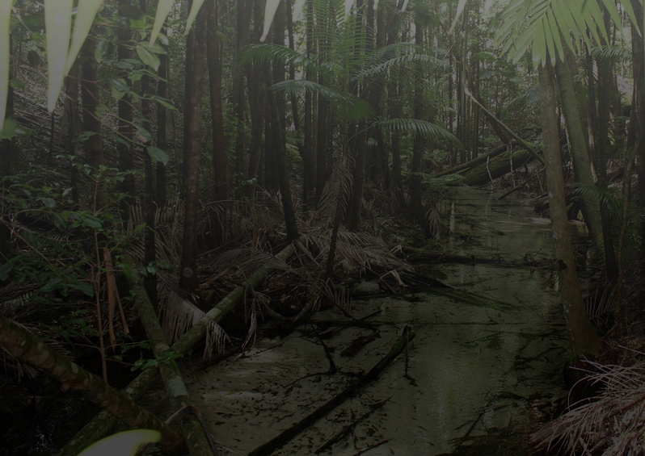
Imagining an Ecosystem: Selecting a Digital Collections Platform for the Library
Graham Hukill, Wayne State University, 2012
Notes:
Allright folks, I’ve got exactly 50 slides in 20 minutes, so let’s Go!

Slide 2
Overview
What is a digital collection?
What is a digital collections platform?
The lay of the land
Our Model
Lessons Learned and Learning

Slide 3
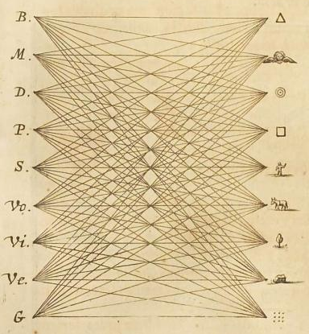
What is a digital collection?

Slide 4
“In general, creating a work in new media can be understood as the construction of an interface to a database.” -Lev Manowich, “Database as a genre of new media” http://vv.arts.ucla.edu/AI_Society/manovich.html
Notes:
I feel as though I would be hard pressed to talk about digital collections and not have this quote.
In this article, Lev is talking about new media objects and how they fit into the traditional narrative of stories and information systems. However, whether he intended to or not, I think it’s a wonderful insight into the nature of digital collections – that they are essentially an interface to a database. For those database minded people out there, almost a view if you will.

Slide 5
“A digital collection consists of digital objects that are selected and organized to facilitate their discovery, access, and use. Objects, metadata, and the user interface together create the user experience of a collection.” -NISO, “A Framework of Guidance for Building Good Digital Collections” http://framework.niso.org
Notes:
When you need to define something, why not turn to NISO – National Information Standards Organization!?
Taking both quotes together, a digital collection begins to look like a group of digital objects that are unified conceptually.

Slide 6
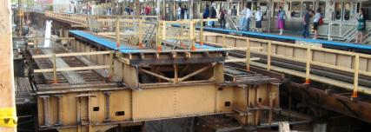
What is a digital collections platform?
Notes:
So with that budding idea of what a digital collection is, what is a digital collection platform? Moreover, an ecosystem?

Slide 7
“A repository is to storage media as a library is to shelves. A storage mechanism is needed, but all public benefit depends upon a repository: a safe place to put content that also provides documentation, preservation and access.” - Richard Wright, BBC
Notes:
This quote is a very succinct explanation of what a digital collections platform accomplishes.
Provides a safe place to put things
Documentation and description about the items
Preservation
and Access
This quote is from a presentation that Karen Cariani, Director of WGBH Media Library and Archives, made. Richard was an engineer at the BBC, and this was his definition of an A/V repository.

Slide 8
Library Mission
“Wayne State University Libraries advance scholarship, student learning and faculty innovation through continuous development of a library that serves as a national model for a research University with an urban teaching and service mission.” - http://lib.wayne.edu/info/about/#mission
Notes:
Before getting into the technical side, it’s important to remember that a digital collections platform should support the mission of the library.
How we will do this:
just like more traditional materials, digital collections can, and should, be utilized for all kinds of research and learning
very diverse collections: Motor City Collection Sunday Journal – strike paper from 95- 98 I think… Ramsey Children’s Book Collection WSU Press materials
Continuous Development
this is HUGELY important aspect of imaging this infrastructure
digital collections have been ad hoc for a long time in the library world, and though technologies and strategies are rapidly taking shape, one of the most CRITICAL aspects of a sound “ecosystem” – and inherent in the idea itself - is one that elegantly evolves over time...

Slide 9
Primary Platform Functions
Store digital objects
Provide access to digital resources
Facilitate search and discovery
Encourage preservation actions and planning
Integrate with Library infrastructure
A steward in the “Information Lifecycle”…
Notes:
Hopefully we’ll touch on all of these as we look at the model in more detail…
Storage
Access
Discovery
Preservation
Cross-platform communication
And stewardship….

Slide 10
But we’re not going to go down that rabbit hole today…
ADMIRAL Data Management lifecycle diagram:
http://imageweb.zoo.ox.ac.uk/wiki/index.php/ADMIRAL_Data_Management_Plan_Template
Notes:
Curating and stewarding information through it’s lifecycle may happen within a digi collections platform - but this presentation is more focused on infrastructure

Slide 11
Digital Collections Ecosystem: Simple Edition
Notes:
We’re going to remain high-level in the “light”
Why an “ecosystem” and not just a “platform”? A platform suggests…
Flat
Singular
Static
At the end of the day, I feel as thought these are the primary three areas a digital collections platform should address.

Slide 12
Digital Collections Platform vs. Institutional Repository (IR)
Are they different? Sure!
Can they be the same? Absolutely!
Is this confusing? You betcha!
Our IR, DigitalCommons@Wayne, focuses on preserving and making accessible scholarly work generated by the University
DC is very good at what it does
Will become a modular / contributing component of our greater Digital Collections “Ecosystem”
Notes:
These thoughts were actually a bit of a joke to myself when I was putting together these slides, but I realized they were pretty accurate.
The boundaries between libraries and archives in the digital realm is nebulous, and many technologies – like software for IR’s and digital collections platforms – weave between them.
*It may be a bit of tangent but much of what differentiates between objects / platforms / theories in the digital realm is a one-way premise.
- for instance, I think of an IR as a bit more constrictive than a digital collection. Think lot’s of Venn diagrams…

Slide 13
Digital Collections Ecosystem: Examples
“From Ingest to Access: A Day in the Life of a HathiTrust Digital Object”
“Islandlives Workflow”
www.hathitrust.org/documents/HathiTrust-PASIG-200910.pdf
http://duraspace.org/fedora/repository/duraspace:118/OBJ/Islandora.pdf
Notes:
Here are a couple examples of Digital Collections Ecosystems.
Quite a few more blocks than our previous three circles
And to be fair, they contain workflows as well….

Slide 14
"A watch, undone": http://www.flickr.com/photos/32943218@N05/6308833700/
Notes:
After some thinking about
What properties the platform should have
What specific arms
What other “ecosystems” look like
the earliest stage of selecting a digital platform feels a lot like this…

Slide 15
The lay of the land…

Slide 16
Open-Source Platforms
DSpace
Originally MIT and HP labs, now Duraspace. open-source, turnkey, IR-esque, OAIS compliant
Fedora Commons
Originally Cornell, now Duraspace, open-source. NOT turnkey, no discovery layer, VERY customizable
Omeka
PHP based, originally designed for metadata and online exhibits
Eprints
Early pioneer in digital repositories, IR-esque, emphasis on text
Notes:
*Our conditions:
This list is only a subset of available platforms out there. As we began thinking about a digital collection “platform”, these were some of the first we considered (minus EPrints), but soon began to realize that “ecosystem” is a more accurate description. That being said, at least DSpace and Omeka are both “turn-key” operations, with file management, search, and display.
Dspace:
The bullets really kind of sum it up. Works with PostGRES and Oracle databases.
Fedora Commons:
The tricky, finicky, but ultimately most extensible and robust option out there.
Fedora does have some pretty mature frontends:
Islandora – Drupal
Blacklight – Ruby on Rails (will discuss more)
Fez – PHP front end
Fabulous, Muradora, The Fascinator (solr), and others, now defunct…
I’ve read quotes from others bemoaning the complexity and over-architecting of Fedora. But maybe just wasn’t a good fit – certainly not a good fit if you just want to save some files.
The trio: Dspace, Fedora, and ContentDM make a large percentage of the digital collections platforms currently out there.
Omeka:
Strengths are online exhibits, which it does well. PHP based.
Eprints:
And then there are Eprints… Pretty clearly now an IR of sorts, it cropped up when these dilineations didn’t exist like they do now.
Started in 2000.

Slide 17
Duraspace?
“the appropriate strategy to avoid the perceived future deadlock in development is to abandon local solutions and seek to utilize other popular Open Source tools that will more appropriately meet the needs of the community.” - http://biecoll.ub.uni-bielefeld.de/volltexte/2011/5167/index_en.html
The best of both worlds in one platform? It might not be that simple…
Notes:
The quote goes on to say: “As such, Solr clearly represents one point of commonality in integrating DSpace and Fedora.”
Best of both worlds?
Unfortunately, might not be that simple. Think of the iPhone. It can take pictures, it makes calls, it can type emails; it’s a compass, it’s a level, a flashlight, a fan. But it doesn’t do any of these things as well or as effortlessly as other appliances.
It’s a balance between isolating tasks and applying the appropriate software, and the convenience of having different components communicate with one another.
Again the iphone is a good example. We are probably all familiar with point and shoot digital cameras. We take a picture, take out the memory card, put it in ta computer, copy the file over to the harddrive, find it, edit it, open up our email, type email, attach image, and finally it’s off to someone. Half an hour later.
The iPhone? Take a picture, click that little “whoosh” arrow and email. Quick, easy, and in this way, **promotes use** This idea of use, promoting use, ease of use, is important.
- In the preservation and access realms, disuse is both a failure of services and a serious threat to the integrity of the digital objects.
So, Duraspace if it works, but making moves to put something in place now.

Slide 18
Other Key Players
Apache Solr
Full-text, faceted search built on Apache Lucene
Fast, open-source, REST-like interface
Very popular, “Best of Breed”
Blacklight
Discovery Interface for Solr
Missing link between users and powerful metadata backend
Ruby on Rails Gem
Notes:
We will touch on these a bit more as we talk about
Solr:
Java “servlet”, HTTP interface
Full-text search, faceted search, database integration
Relevancy Ranking – mention “Gone with the Wind” example
JSON, XML, PHP, Ruby, Python, XSLT, Velocity and custom Java binary output formats
Industry standard: used by Internet Archive, HathiTrust, The Guardian, Instagram, you get the picture…
Blacklight:
Contributing institutions: UV, Stanford, John Hopkins, WGBH
*just learned a ton today about it….
Unicode
RSS feeds “plugin” works right out of the box
SolrMARC is the combination of VuFind and Blacklight projects

Slide 19
Other Key Players
Hydra: “Hydra is an ecosystem of components that lets institutions deploy robust and durable digital repositories (the body) supporting multiple “heads”: fully-featured digital asset management applications and tailored workflows. Its principle platforms are the Fedora Commons repository software, Solr, Ruby on Rails and Blacklight.” - http://projecthydra.org/
Notes:
This is a glimpse into not only how these modular components are being used, but how they are co-evolving together.
If we become familiar and utilize these technologies now, we will be that much more equipped to evaluate and adopt systems such as Hydra as they mature...

Slide 20
Yale’s “Office of Digital Initiatives and Assets” (ODAI)
“This diagram does not identify every system at Yale. Rather, it illustrates the type and relationship of modular systems that constitute a comprehensive approach to digital content management.”
- http://odai.yale.edu/planning-and-architecture
Notes:
ODAI – I’m terrible with acronyms, but I could remember this from the moment I first heard it. Initiatives and Assets, Interfaces and Databases…makes a lot of sense to me.
Furthermore, their thought process seems very sound to me. It is an acknowledgement that the systems need to communicate, that comprehensiveness in planning is critical. Even utilizing 3rd party services like YouTube where applicable…

Slide 21
Our model

Slide 22
"The key to the interoperability of digital cultural content, and in fact any digital collection, is consistency . . . inconsistent digital collections require … more complex, costly and unreliable systems and processes.”
- http://mirror.dlib.org/dlib/january02/gill/01gill.html
Notes:
It has been, and will continue to be, a driving force in our thinking about a digital collections ecosystem.
Just having some pieces in place will engender consistency

Slide 23
“...one thought to consider is that we are trying to tackle technology incompatibility which is often caused by proprietary software and formats. Therefore, it’s a little ironic to implement proprietary software tools to manage this problem.” http://blogs.loc.gov/digitalpreservation/2012/10/archivematica-and-the-open-source-mindset-for-digital-preservation-systems/
Notes:
This is perhaps one of my favorite quotes and thoughts on this issue. From an interview of the makers of Archivematica.

Slide 24
Desired Platform Characteristics:
Open-source, Free
Flexible, Iterative, and Agile Development
Modular
Support Preservation Activities
Facilitate Discovery
Robust and API-like methods for Access
Notes:
Open-Source: Libraries aren’t made of money, but also keep in mind that open-source software – like the data – will remain more “open” for longer.
Iterative / Agile development is a mindset centered around “iterative and incremental development”
Modular: makes adopting new technologies, swapping out old ones, and sometimes even troubleshooting easier. But most of all, it’s good in theory, to adopt technologies that are designed for a specific purpose. Think again of the poor iPhone pictures….
Preservation: Essential part of a digital collections platform.
In the digital realm, preservation and access have a unique tension. Unlike traditional materials like print photographs or books, where they can sit on a shelf for 100 years and be fine, digital objects require constant attention, even migration. So preservation is tied to both the storage system (Fedora / DSpace bitstream preservation for example) and accessibility and discovery of materials (making materials more valuable through exposure)
Discovery: seemingly obvious, but historically VERY poor in digital collections platforms. This is tied to the next one...
Access: We can save the bits, we can even make the metadata discoverable, but if we can’t present them in a fashion usable and desirable by patrons, it’s all for naught.
API’s is a shared language or set of specifications for interfaces to communicate with each other.
Thinking back to the Lev Manovich quote, that objects are the construction of an interface to a database, it becomes more clear why this is important. Each Access Point is merely an API shaped into an interface.
It reminds me a band or a choir, where you know particular components will respond with particular noises. Based on this pre-determined behavior, elaborate works can be built from aggregate parts.
Hope we will demonstrate how a simplistic model, with pre-existing open-source software can satisfy these requirements

Slide 25
Our Current Infrastructure
DLXS
Omeka
Mirrored Linux / Ubuntu file system
Discovery through catalog
Ad hoc collection interfaces
not necessarily a bad thing…
Notes:
DLXS: Created by the University of Michigan, was a workhorse for a long time, but is no longer supported. It’s time has come.
Omeka: Excellent software for creating online exhibits, with simple setup, it does not satisfy other areas like preservation or access
Linux File System: Still perhaps the most lightweight, flexible, and simple approach to simple file storage, this will continue to serve an important function
Catalog: While Most of our digital objects / collections are searchable through the catalog, you are often sent to disparate access locations with an inability to search or browse between them. That being said, we will still strive to include as much as we can in the catalog. Catalogs are evolving too...
Ad Hoc Collection Interfaces: Some of the collections are DLXS, some Omeka, some pure HTML and file system. While the backend is not sufficiently consistent to support this in the long-term, the case can certainly be made for unique interfaces, and will probably play a role in our infrastructure

Slide 26
Current Infrastructure
Ideal Infrastructure
Notes:
Current: Inconsistent organization and description. “Silos” of data (see form on right)
Ideal system: modular, stackable, tightly-knit

Slide 27
The Reality
When envisioning different layers, components are co-dependant
Researching different approaches and software reveals new pieces and eliminates others
Notes:
The reality in “imaging a digital collections ecosystem” is one of juggling ideas, considerable research, and the willingness to adopt new ideas. I simply could not think of an image that conveyed this process more than multiple tetris pieces frozen in midair: - it’s possible, people have done it
- but pieces are very co-dependant
Example:
What shall we use for discovery? If we choose Backlight, that is assuming a Solr backend somewhere.
Or if we use DSpace as a file structure, then dublin core will be mainstay in our system
Think back to the watch diagram: sometimes you kind of have to hold a spring in place while dropping in another sprocket…
Abbyy FineReader, our OCR software, is currently only available on a Windows VM
This is VERY problematic for workflows, and involves new pieces (Samba)

Slide 28
Our Model A work in progress…
“…a minimal set of requirements and services that must be in place to effect the infrastructure of a universal, open, wide-area digital information infrastructure system (“the System”). - http://dx.doi.org/10.1007/s00799-005-0128-x
Notes:
Our proposed system, at the very highest level.
Walk through the arrow: 1) Users interact, search, and browse through a Blacklight discovery layer
2) Blacklight is pulling information from a Solr index of METS files
3) When a digital object is called, the METS file is pulled from the MySQL database
4) This is sent to the appropriate access application
5) The application from the Access Stack determines what files to pull from Storage to render from the METS file
6) These are returned and displayed for the user
7) It is conceivable, even likely, that some of the Access Stack components will integrate with the Blacklight as well. University of Wisconsin Madison’s site is a good example of this (we’ll get there in a second...)

Slide 29
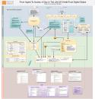
A HathiTrust subset
Notes:
This is just a fraction of the overall HathiTrust model – touching on components of our proposed system we will be talking about.

Slide 30
File Structure
Simple Linux File System at first, transition into OAIS inspired system (Fedora, DSpace)
Fully mirrored storage
Self-describing File System
METS files will be duplicated in SQL storage and in file system
Notes:
Linux File System:
where bitstream (actual bytes, 0’s and 1’s) and descriptive information (metadata) are split
Even in just the last few days, Fedora is emerging as a likely backend for our infrastructure:
- Fedora is developed with a RESTful API, removing the need to write communication scripts and transformations yourself
- Provides much more opportunities for preservation actions.

Slide 31
METS objects
XML
Descriptive and Structural information about objects
wrapper for other metadata formats (DC, MIX, MARC, PREMIS, etc.)
Central to the overall architecture
Flexibility: constituent pieces can be located anywhere
Consistency: normalized metadata for all objects
Interoperability: digital objects accessible by various systems
Widely adopted
<file ID="FID1" GROUPID="2" USE="Image-Service-MedRes">
<FLocat LOCTYPE="URL" xlink:type="simple" xlink:href="letter_city00001.jpg"/>
</file>
.....
<div ORDER="1" LABEL="page01" DMDID="dm2" TYPE="page">
<fptr FILEID="FID1"/>
</div>
Notes:
XML:
METS is essentially a wrapper for other formats,
- structural map of constituent objects (remember, this can be files or even other objects)
- also, PREMIS is particularly suited to preservation

Slide 32
METS objects
Provides a framework to handle different kinds of digital objects.
#1 – somewhat typical “digital collection”
#2 and #3 – eTexts
#4 – “atomistic” digital object, containing select pieces of other objects
Similar to “collection” at scale and breadth perhaps, but fundamentally a bit different
Notes:
#1 “Typical Collection”
#2, 3 “eTexts”, fairly simple “complex” objects
#4 “atomistic” object, pulling pieces from other objects
- these just feel different to me, like a mashup, but should all be managed well by METS files

Slide 33
Metadata Index & Database
Searchable store of METS files
Backend to Discovery layer (Blacklight)
Ancillary to Access layer (various components)
Solr
Java “servlet”, HTTP interface
Full-text search, faceted search, database integration
JSON, XML, PHP, Ruby, Python, XSLT, Velocity and custom Java binary output formats
Industry standard: used by Internet Archive, HathiTrust, The Guardian, Instagram, you get the picture…
Notes:
I think of this as the “brains” of the infrastructure, the metadata store behind the discovery and information for the access pages.
I don’t have a picture here of this particular piece, but it’s mostly just the same XML from a couple slides back.

Slide 34
Discovery Layer
Critical component, often first point of contact with collections for users
Search within, and across, collections
Search all material types (visual, text, A/V)
Much of the “look and feel” of a digital collection and the digital collection environment
Potential for accessing and presenting digital objects as well

Slide 35
Current landscape...
- Howard Besser, “The Next Stage: Moving from Isolated Digital Collections to Interoperable Digital Libraries.”
Notes:
Move…

Slide 36
What it could look like...
- Howard Besser, “The Next Stage: Moving from Isolated Digital Collections to Interoperable Digital Libraries.”
Notes:
Quickly….

Slide 37
Discovery: Blacklight
NC State – “Historical State 125”
http://historicalstate.lib.ncsu.edu/
Notes:
Nice, clean, crisp, design.

Slide 38
Discovery: Blacklight
University of Wisconsin Madison – Library Catalog
http://search.library.wisconsin.edu/
Notes:
UW Madison’s library catalog,

Slide 39
Discovery: Blacklight
Stanford – “SearchWorks” Library Catalog
http://searchworks.stanford.edu/
Notes:
Stanford’s “SearchWorks” – using Blacklight as an alternative discovery interface, including their digital collections and other materials, it is poised to become their primary discovery interface….

Slide 40
Discovery: Blacklight
New York Public Library
Andre Studios 1930 – 1941
http://andrestudios.nypl.org/browse
Notes:
“here are different ways to browse our items…” acknowledges that one size no longer fits all, nor should it
not a huge fan of word clouds, but pretty effective in this case, a good example of that princicple
Made possible by modular backend

Slide 41
Access
Receives requests from discovery layer
Read appropriate METS file
Pull digital objects from “storage”
Provide access / interface for these materials
Types
Images
eTexts
Audio / Video
Notes:
This stack will be the most varied, with homegrown, proprietary, and other applications in place to render materials once found and retrieved.
Might integrate more closely with the Discovery layer (images, A/V),
but still a need, even a desire for stand-alone interfaces as well:
- eText Reader
- ad hoc collection pages (told you it wasn’t such a terrible thing)
- Shana Kimball actually came to speak here on campus yesterday for OA week about projects at M-Publishing. One was a joint project about Influenza, where they designed essentialyl a webpage for the landing page. It was lovely, and we have done similar things.

Slide 42
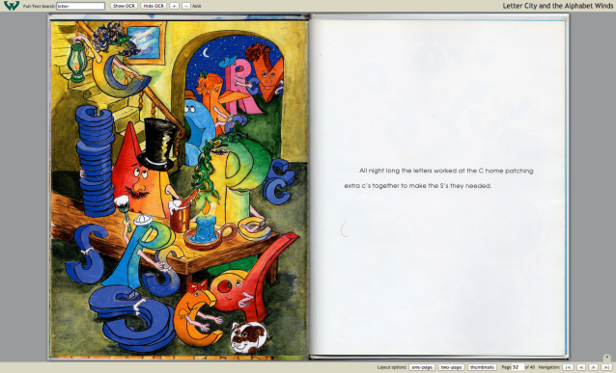
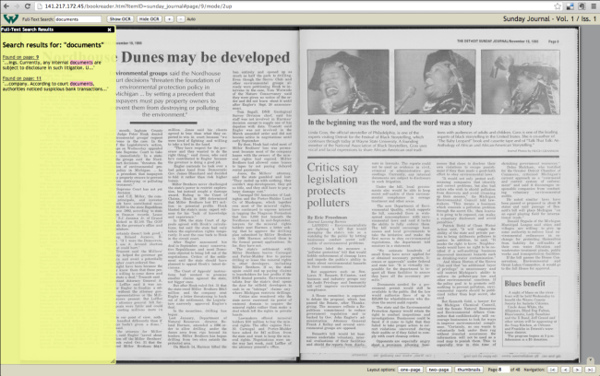
Access – eText Reader
Notes:
- Built on the Internet Archive’s Book Reader software
-GNU license, other institutions include IA’s own Open Library, LOC, Stanford, Princeton,
Currently using Solr index for metadata about books
Transition to METS files

Slide 43
Not so fast… METS files
Creation of METS files can be time consuming, and very different for different kinds of materials
At right, simplistic model of how to ingest and create METS files for eTexts
“METS creation tool”, while handy, requires human intervention
Notes:
One of the more difficult and time consuming activities will be creating METS files for our digital objects

Slide 44
Not so fast… METS files
Archivematica
Batch, recursive processing of items
Focused on preservation (AIP creation)
very descriptive METS files (JHOVE, Droid, etc.)
Archivist's Toolkit (AT)
Java application, difficult to batch process
Requires SQL backend, finicky
Notes:
First of all, interesting to note that digital libraries are turning to tools like Archivist’s Toolkit and Archivematica, convergence…
“Overkill” – wrapping up here, it’s something worth focusing attention on. All this open-source, all these “micro-services”, the name of the game is really trying to remain agile as you feel things out.
Archivematica is a lovely bit of software, but it might back us into a workflow we’re not ready for yet.
Doesn’t make sense to enter information into an interface / database, then not use it

Slide 45
Lessons Learned and learning

Slide 46
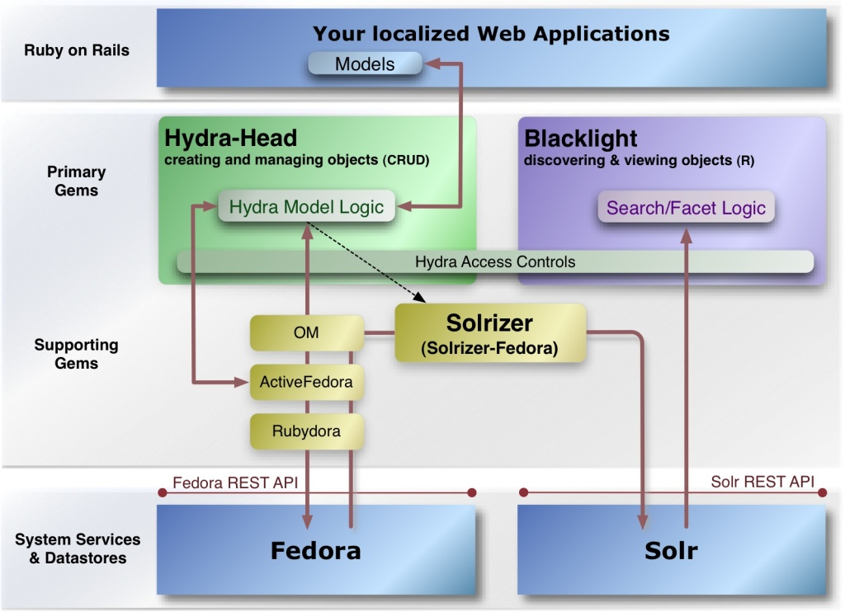
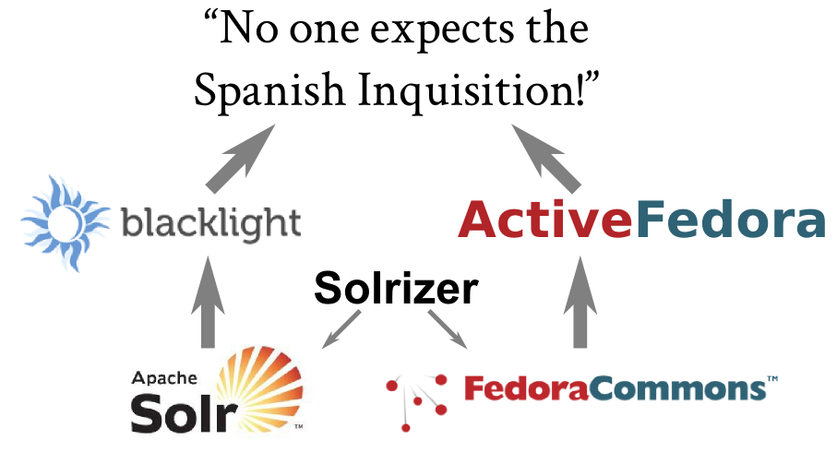
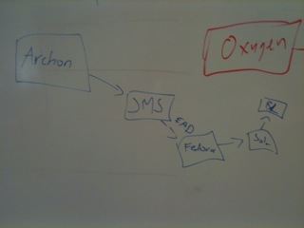
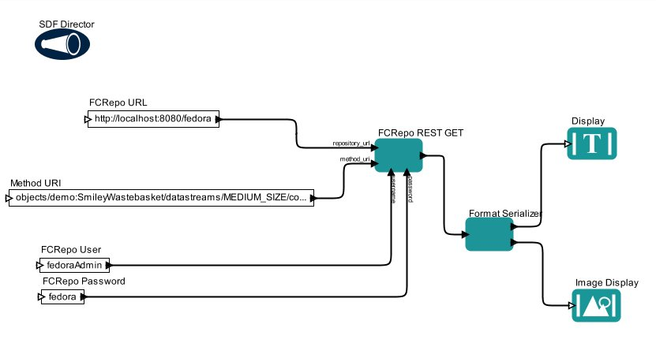
We’re on the right track!
http://code4lib.library.nd.edu/c4l11/source/diagrams/ia-inq-all.png
https://wiki.duraspace.org/download/attachments/22022608/Hydra+Architecture+DiagramV2.jpg
https://wiki.duraspace.org/display/FEDORACREATE/REST+API+Tests
https://wiki.duraspace.org/display/hydra/EAD+in+Hydra-Blacklight-Atrium
Notes:
From many other websites, and many other wikis, it seems to be where folks are headed.
Clockwise
Duraspace wiki...looks to be Hyrda implementation
Image from Notre Dame presentation at Code4Lib
Example of calling image with Fedora API
Northwestern diagram with Fedora, Solr, and BL for EAD’s
But the very best part? We found these after we had started to dream up this scenario...

Slide 47
Asking fundamental questions about our digital materials, what digital collections are, has been key
Sometimes by envisioning an ideal solution, we uncovered others who had trod similar ground
“These “Best of Breed” solutions should always be considered over local homegrown tooling.” - http://biecoll.ub.uni-bielefeld.de/volltexte/2011/5167/index_en.html
Utilize the hard and spectacular work of others
But sometimes the works has not been done. If not, why not?
Notes:
This is my quintessential:
“Don’t reinvent the wheel slide”
But it’s true.
Blue-Sky questions
Our team has tried to sit down for blue-sky sessions to think through some of these processes
“Best of Breed”
You can see this from the past slide, than MANY people are doing similar things.
- interesting though: if something has not been done, why not? Perhaps there is an obstacle or unseen challenge that others have encountered.
- This harks back to the Tetris example where pieces just seem to vanish and appear….

Slide 48
In these diagrams, sometimes the “arrows” are the most challenging bits to reconcile
API interactions
Often require crosswalking or transformation of information
Internet Browsers are the most powerful and consistently updated pieces of software around
Internet Archive’s Book Reader pure HTML, CSS, and Javascript
Notes:
As mentioned in the thought process behind adopting Fedora as our storage backend, communication (like the people world) is often the most difficult part. You may have a file, and a database that knows that file exists, and an access layer application that want is, but having that conversation requires quite a few short, quick API calls. Or what should be short and quick…
This is exciting to me. And to bring things kind of full circle, that idea of Interfaces <--> Databases. The browsers are powerful, the databases pretty well established, but we need to create that interfacing middle ground for users.

Slide 49
Discoverability and Access across collections should be available from one location
storage and metadata layers can provide collections and objects through API’s to other – and even yet unforeseen - systems
Occasionally step back and ask:
Is this system more consistent and versatile than before?
Will it scale? can it evolve?
Is this what our users want? what our collections need?
Notes:
Discoverability & Access from a single location:
By utilizing and indexing METS files, our Access layers – while admittedly complex in their own right – are conceptually simple. A unified discovery layer is possible by creating these METS “handles” for digital objects at all scalar levels.

Slide 50
Thanks! Questions?
Graham Hukill, Wayne State University, 2012

Slide 51
References
Images
ADMIRAL Data Management lifecycle diagram: http://imageweb.zoo.ox.ac.uk/wiki/index.php/ADMIRAL_Data_Management_Plan_Template
Stanford "SearchWorks" screenshot: http://searchworks.stanford.edu/
NC State screenshot: http://historicalstate.lib.ncsu.edu/
John Hopkins University Youtube screenshot: https://catalyst.library.jhu.edu/
UW Madison screenshot: http://search.library.wisconsin.edu/
NYPL screenshot: http://andrestudios.nypl.org/browse
"A watch, undone": http://www.flickr.com/photos/32943218@N05/6308833700/
"Blueprint": http://www.flickr.com/photos/wscullin/3770016707/
"Donovan School (Ann Arbor, Mich.) Miss Lily E. Goodhew teacher, Feb. 1911.": http://quod.lib.umich.edu/b/bhl/x-bl000298/bl000298

