Slide 1
Open Access: What We’re Doing and Where You Fit In
Joshua Neds-Fox
Wayne State University Libraries
jnf@wayne.edu
October 24, 2012
Notes:
Open access everywhere, and the trend toward open access
What is Open Access, diff. between hues of access
OA and specific metrics, faculty perceptions
Wayne State Library initiatives / provisions for OA

Slide 2
Open Access Landscape
Since 2002, the open access movement has impacted areas of information dissemination and policy across the globe
Sources: Heather Morrison, "Dramatic Growth of Open Access", http://hdl.handle.net/1902.1/14446 V14. Updated 12/31/2011 (Accessed 10/2012); http://roarmap.eprints.org/ (Accessed 10/2012); http://www.doaj.org (Accessed 10/2012); http://www.plosone.eorg (Accessed 10/2012); http://www.opendoar.org/ (Accessed 10/2012)
Notes:
OA Repos
The number of repositories have grown tremendously since 2005, from 400 to just over 2200 today. These 2200 repositories are collectively contributing an average of over 14,000 open access items per day.
8300 OA Journals to date, in 2005 there were 1503 OA journals .. In the last month the DOAJ added on average 3 journals every day
PLoS ONE is the largest journal in the world, publishing almost 14,000 articles in 2011 (turnaround time of 9 days)
OA Mandates
As of October 2012, there are more than 347 open access mandates adopted by institutions worldwide. 55 of these mandates have been adopted in 2011, another 38 in 2012.
Quicker turnaround times, quicker dissemination of information, easier exchange, hopefully an increase in the production of new knowledge and ideas

Slide 3
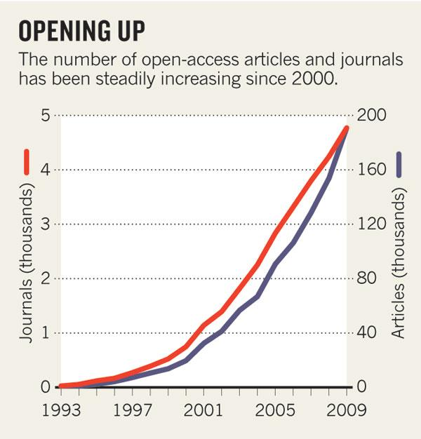
Open Access Landscape
OA journals are growing at 15% a year, while subscription journals are growing at 3.5% a year.
Source: M. Laakso et al. PLoS ONE 6, e20961 (2011) .
Notes:
The analysis, by information scientist Mikael Laakso of the Hanken School of Economics in Helsinki and his colleagues, also found that the number of fully open-access journals is growing at around 15% every year as new journals are founded and subscription journals switch to the open-access model (see 'Opening up'). By contrast, subscription journals are growing at about 3.5%. "Most indicators suggest growth is not slowing," says Laakso. "The open-access publishing model has proven itself to work.”
OA Mandates are adopted by diverse institutions as the Welcome Trust, the World Bank, Harvard, MIT, Brandeis, Emory, Princeton, Columbia, Cornell, U Penn, Duke, famously the NIH

Slide 4
What is OA?
Public Library of Science has a succinct definition:
“All PLOS content is Open Access, meaning it is freely accessible online to everyone, everywhere.”
http://www.plos.org/#4
Notes:
OA removes price barriers and permission barriers
10 years ago: Budapest-Bethesda-Berlin
“The best-known part of the BBB definition is that OA content must be free of charge for all users with an internet connection. However, the BBB definition doesn't stop at free online access. It adds an extra dimension that isn't as easy to describe, and consequently is often dropped or obscured. This extra dimension gives users permission for all legitimate scholarly uses. It removes what I've called permission barriers, as opposed to price barriers. The Budapest statement puts the extra dimension this way:
By "open access" to this literature, we mean its free availability on the public internet, permitting any users to read, download, copy, distribute, print, search, or link to the full texts of these articles, crawl them for indexing, pass them as data to software, or use them for any other lawful purpose, without financial, legal, or technical barriers other than those inseparable from gaining access to the internet itself. The only constraint on reproduction and distribution, and the only role for copyright in this domain, should be to give authors control over the integrity of their work and the right to be properly acknowledged and cited.
The Bethesda and Berlin statements put it this way: For a work to be OA, the copyright holder must consent in advance to let users "copy, use, distribute, transmit and display the work publicly and to make and distribute derivative works, in any digital medium for any responsible purpose, subject to proper attribution of authorship".
All three tributaries of the mainstream BBB definition agree that OA removes both price and permission barriers. Free online access isn't enough. "Fair use" ("fair dealing" in the UK) isn't enough.”
BBB requires removing barriers to copying and redistribution. It doesn't require removing barriers to commercial re-use

Slide 5
What is OA?
Two models:
Gold OA: Open Access Journals
Peer Reviewed, some charge author fees
Green OA: Open Access Repositories
Hosts content created/vetted elsewhere (preprint, postprint), generally charges no fees.
http://www.plos.org/#4
Notes:
Diff between pre- and post- print:
A preprint is any version prior to peer review and publication, usually the version submitted to a journal.
A postprint is any version approved by peer review. Sometimes it's important to distinguish two kinds of postprint: (a) those that have been peer-reviewed but not copy-edited and (b) those that have been both peer-reviewed and copy-edited. Some journals give authors permission to deposit the first but the not the second kind in an OA repository.

Slide 6
Green OA and
Citation Impact
Lawrence, Nature 411 (2001):
Free online availability substantially increases a paper’s impact
Norris et al, J of the Am. Soc. For Info Sci & Tech 59.12 (2008):
The citation advantage of open-access articles
Gargouri et al, PLoS One 5.10 (2010):
Self-Selected or Mandated, Open Access Increases Citation Impact for Higher Quality Research
Summary of research at: http://eprints.soton.ac.uk/268516/2/Citation_advantage_paper.pdf
Notes:
LAWRENCE:
120,000 peer-reviewed conference articles, found a mean citation increase to OA articles of 157%.
NORRIS:
4633 articles: OA mean citation count: 9.04; TA: 5.76
GARGOURI
Background: Articles whose authors have supplemented subscription-based access to the publisher’s version by self-archiving their own final draft are cited significantly more than articles in the same journal and year that have not been made OA (the “OA Advantage”). Could be that authors make higher quality articles OA (‘self-selection bias’)
Conclusions/Significance: The OA advantage is greater for the more citable articles, not because of a quality bias from authors self-seleting… but because of a quality advantage from users self selecting what to use and cite, freed by OA from the constraints of selective accessibi,ity.

Slide 7
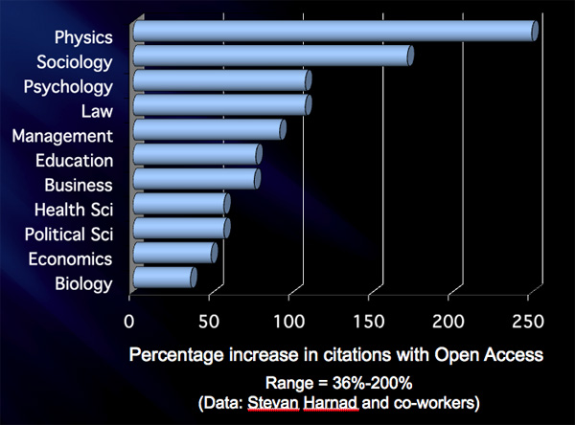
Green OA and
Citation Impact
Open access articles are viewed and cited more frequently than non-open access articles
Download advantage
Competitive advantage
Accessibility advantage
Source: Brody & Harnad (2004). “Comparing the Impact of Open Access (OA) vs. Non-OA Articles in the Same Journals.” D-Lib Magazine, 10(4), Available at http://www.dlib.org/dlib/june04/harnad/06harnad.html

Slide 8
2011 Survey of
NIH Funded Faculty
On the one hand, acknowledgement of the importance of Open Access:
70% agree they’d deposit published articles to an IR if library provided service
92% agree that open access to publicly funded research results is important.
Notes:
Conducted by Jon McGlone and Deborah Charbenneau
70% either strongly agree (40%) or agree (30%) they’d deposit published articles to Digital Commons if library provided service.
92% strongly agree (59%) or agree (33%) that open access to publicly funded research results is important.

Slide 9
2011 Survey of
NIH Funded Faculty
On the other hand, disconnect between desire for open access to publications and knowing how to make that happen:
62% of respondents don’t consider “self-archiving” ability to be important when publishing in a journal (least important factor)
97% don’t modify publishing agreements
62% didn’t know about WSU’s institutional repository
Notes:
Disconnect between desire for open access to publications and knowing how to make that happen.
62% of respondents don’t consider “self-archiving” ability to be important when publishing in a journal (least important factor)
97% don’t modify publishing agreements
62% didn’t know about WSU’s institutional repository
Top Library Services Desired to Assist Publication Activities
Cost-sharing program to publish in open access journals (61%)
Online tutorials/help about Digital Commons (54%)
Self-archiving services for Digital Commons (51%)

Slide 10
OA Initiatives
at Wayne State
Outreach: Author’s rights, Copyright, Scholarly communication education
http://guides.lib.wayne.edu/scholarlycomm/

Slide 11
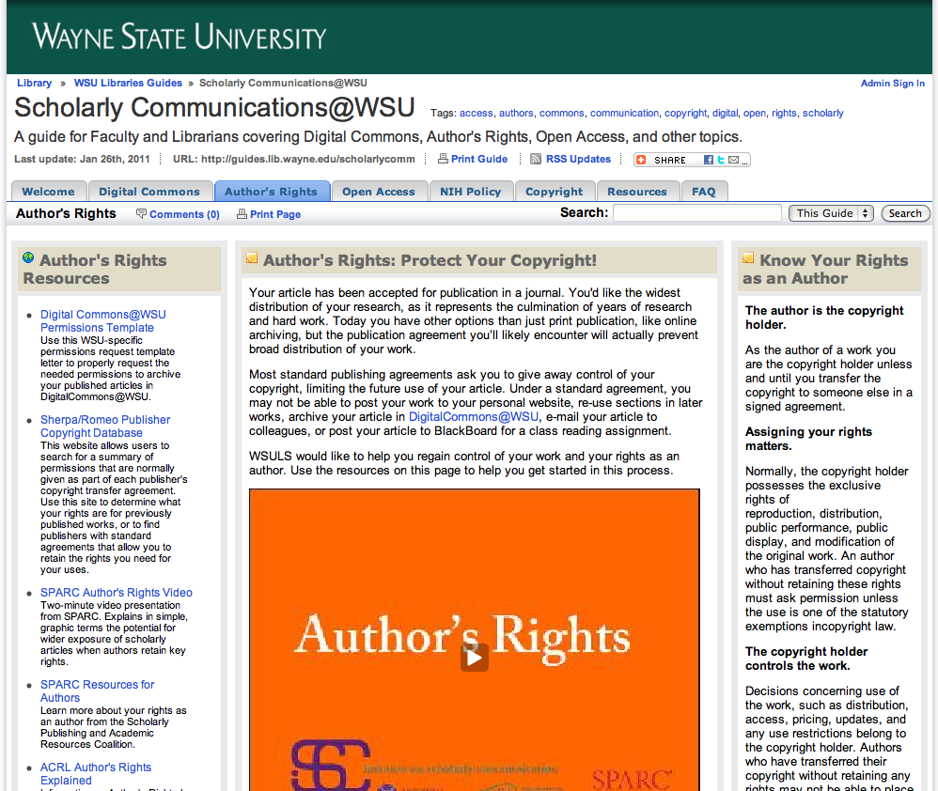
OA Initiatives
at Wayne State: Author’s Rights
Permissions Templates
Author Addendum Generator
Handouts and Workshops
Notes:
Stats on ETDs accessed in Digital Commons

Slide 12
OA Initiatives
at Wayne State: ETDs
561 dissertations
32% Open Access
Open access advantage:
78 Downloads/OA Item
8 Downloads/Closed Item
186 theses
20% Open Access
Open access advantage:
113 Downloads/OA Item
8 Downloads/Closed Item
Notes:
History of Proquest / Policy re: TDs in the Library
Stats on ETDs accessed in Digital Commons
One Thesis has been download 1579 times since Sept. 2010!
Other things with Digital Commons:
E-Journal Hosting
Unit Publications
Conference Proceedings
-----------------------------------
…but our chief OA initiative is Digital Commons

Slide 13
Green OA at Wayne State
DigitalCommons@Wayne State: http://digitalcommons.wayne.edu
an open access scholarly publishing service available to WSU faculty, staff, and students;
a permanent archive for WSU research and scholarly output, providing perpetual access to materials as broadly as possible.
Notes:
Funded and supported by the Library System since 2005
Members of the WSU community can highlight their published scholarship using this library digital publishing program. Working with faculty and departments across the university, the library deposits publications into a central, online archive as a means of providing global, open access to journal articles, technical reports, working papers, conference papers, workshop materials, and similar works of scholarly nature.
We want to publish WSU and WSU-affiliated:
Published articles (post-prints)
Presentations, talks, unpublished manuscripts, working papers
Datasets and other supplemental materials
Paper/seminar series
Conference proceedings
Out-of-print books
Teaching materials
Research, scholarship, or creative activity of any kind
Journals
Conferences + Events
DigitalCommons…
Receives and archives one electronic copy
Preserves this copy permanently
Creates a short and stable URL with a wayne.edu address

Slide 14
Green OA at Wayne State
Track interest with monthly readership reports automatically sent to your e-mail for each article deposited in DigitalCommons
Metrics:
124,836 Full-text downloads since inception
Over half of those in the past year (73K)
Notes:
Number of Downloads automatic. Hits available on request.

Slide 15
Green OA at Wayne State
Accessible immediately, worldwide
Identified with author’s name, date of submission, original citation
Collected together in one place
Allows wider distribution of scholarly work (outside typical author’s network)
Notes:
What’s in it for me?
Retention of copyright
Increased citation rates
Google search optimization
Perpetual access & preservation
Comprehensive usage data
Free setup, training & support

Slide 16
Green OA at Wayne State
67% of traffic comes from Google and Google Scholar
Full-text indexed by search engines
BePress actively works with Search Engine companies to revise and improve discoverability
Library Digital Publishing takes care of the rest
Harvested by worldwide library catalogs
Notes:
Digital Commons supports the Open Archives Initiative Protocol for Metadata Harvesting (OAI-PMH) 2.0

Slide 17
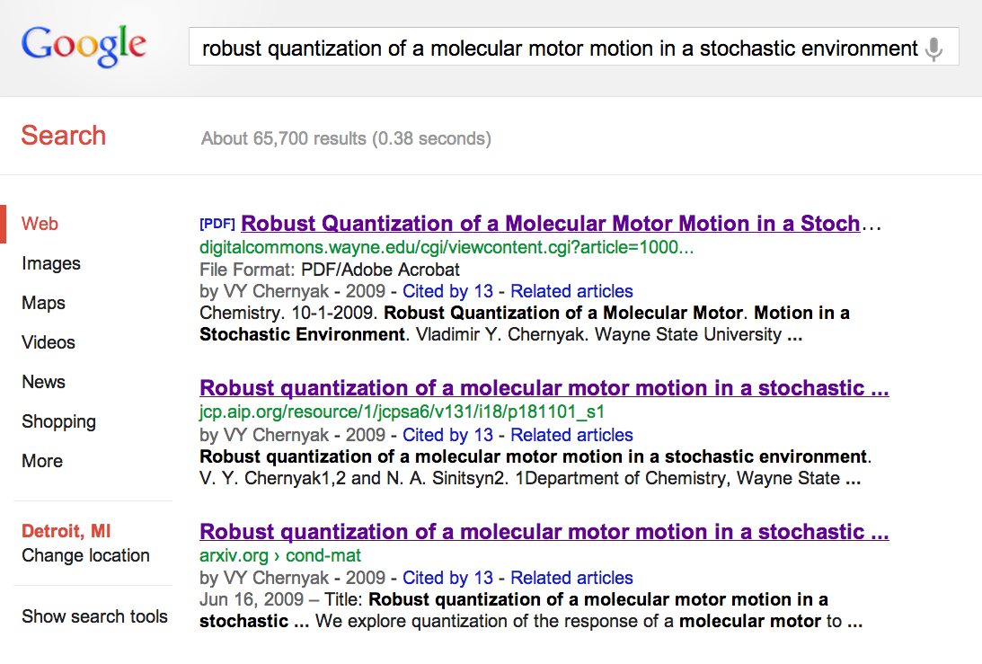
Green OA at Wayne State

Slide 18
Green OA at Wayne State
Who controls copyright in DigitalCommons?
The author/creator or the party to whom copyright has been sold or licensed by the author.
Not the library; not the university; not BePress

Slide 19
Finding Journals with
Author-Friendly Policies
http://www.sherpa.ac.uk/romeo
Notes:
So, you need to identify which of your prior publications (or future publications) are friendly to Green OA .

Slide 20
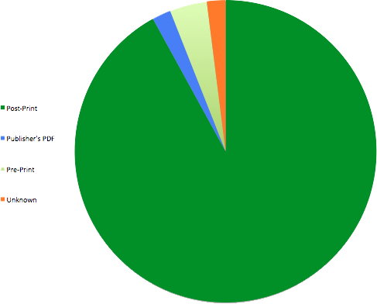
Green OA and
Communication Journals
Analysis of top 50 communication journals in JCR shows that 47 allow for self-archiving.
Check Sherpa/Romeo for publisher policy.

Slide 21
Becoming OA:
Educate Yourself
Peter Suber’s Open Access Overview:
http://www.earlham.edu/~peters/fos/overview.htm
Open Access Scholarly Information Sourcebook:
http://www.openoasis.org/
SPARC (Scholarly Publishing & Academic Resources Coalition)
http://www.arl.org/sparc/
WSU Libraries’ Scholarly Communications Guide
http://guides.lib.wayne.edu/scholarlycomm/
Notes:
Peter Suber, Director of the Harvard Open Access Project and senior researcher at SPARC. His book, Open Access, came out this summer from MIT Press and becomes fully OA in June of next year.
OASIS, spearheaded by two pioneers in Open Access issues; Among other goals:
“OA and associated issues move fast, and data and information on Open Access quickly become out of date. It will be a major responsibility of this service to keep information updated and relevant to current developments”
SPARC, a leader for over 15 years, works in education and advocacy to address the crisis in scholarly communication / publishing

Slide 22
Becoming OA:
Negotiate your Copyright
Using an addendum, author can unbundle copyrights and transfer only some to them to publishers
http://guides.lib.wayne.edu/scholarlycomm/
Notes:
A set of laws designed to give creators a package of rights over their original works of authorship
Create a derivative work or translations
Reproduce the work in copies
Distribute copies
Perform or display publically and digitally
Authorize others to exercise any of these rights
Copyrights can be bought, sold, willed to others, or given away.
A transfer of the copyright or an exclusive grant or license to use the work is a transaction that must be conveyed in writing.
OA publishing approaches copyright issues under the same two approaches as TA publishing:
Public domain
Permission of the rightsholder
In cases where OA permissions aren’t explicit in the publishing contract
Delayed (ASA, ie.)
Freely accessible versions
Author Version posted immediately
Publisher Version posted 6 months after publication
Immediate
Publisher version freely accessible upon publication
MIT uses this for Faculty Open Access Mandate compliance
Access/Re-Use
Publisher version freely accessible upon publication
Gives work a Creative Commons license, sharing your distribution rights. Public can also re-use/post so long as you are:
Given credit as author
Reader’s use is non-commercial
We have an addendum generator at LibGuide

Slide 23
Becoming OA:
Incorporate OA into your Workflow
Submit pre-print to Journal of your choice
Accepted to peer-review, iterative revision process.
Journal acknowledges final accepted manuscript (post-print)
Send that version to the Library!
Journal publishes.
Library takes care of archiving as permitted

Slide 24
Getting Started: DIY
Find an existing series (Communication Faculty Research Publications, for example)
Login, or register
Begin to upload your own Word/PDF files
Abstract
Keywords
Citation Information (if already published)
PDF/.doc copy of article/chapter
Additional files, if desired (datasets, images)
Notes:
Do It Yourself

Slide 25
Getting Started: DIFM
E-mail me your/another’s vita or list of publications.
There is no second step.
jnf@wayne.edu or
digitalcommons@wayne.edu
Notes:
Do It For Me

Slide 26
Questions
This presentation is OA and available at:
http://digitalcommons.wayne.edu/libsp/55/
Joshua Neds-Fox
Coordinator for Digital Publishing
jnf@wayne.edu | 7-4460 | 172 Purdy Library

