Slide 1
Open Access Journals A Good Way To Go?
Alexandra Sarkozy
Joshua Neds-Fox
Wayne State University Libraries
ff2662@wayne.edu | jnf@wayne.edu
October 10, 2012

Slide 2
What is OA?
Public Library of Science has a succinct definition:
“All PLOS content is Open Access, meaning it is freely accessible online to everyone, everywhere.”
http://www.plos.org/#4
Notes:
OA removes price barriers and permission barriers
10 years ago: Budapest-Bethesda-Berlin
“The best-known part of the BBB definition is that OA content must be free of charge for all users with an internet connection. However, the BBB definition doesn't stop at free online access. It adds an extra dimension that isn't as easy to describe, and consequently is often dropped or obscured. This extra dimension gives users permission for all legitimate scholarly uses. It removes what I've called permission barriers, as opposed to price barriers. The Budapest statement puts the extra dimension this way:
By "open access" to this literature, we mean its free availability on the public internet, permitting any users to read, download, copy, distribute, print, search, or link to the full texts of these articles, crawl them for indexing, pass them as data to software, or use them for any other lawful purpose, without financial, legal, or technical barriers other than those inseparable from gaining access to the internet itself. The only constraint on reproduction and distribution, and the only role for copyright in this domain, should be to give authors control over the integrity of their work and the right to be properly acknowledged and cited.
The Bethesda and Berlin statements put it this way: For a work to be OA, the copyright holder must consent in advance to let users "copy, use, distribute, transmit and display the work publicly and to make and distribute derivative works, in any digital medium for any responsible purpose, subject to proper attribution of authorship".
All three tributaries of the mainstream BBB definition agree that OA removes both price and permission barriers. Free online access isn't enough. "Fair use" ("fair dealing" in the UK) isn't enough.”
BBB requires removing barriers to copying and redistribution. It doesn't require removing barriers to commercial re-use

Slide 3
What is OA?
Two models:
Gold OA: Open Access Journals
Peer Reviewed, some charge author fees
Green OA: Open Access Repositories
Hosts content created/vetted elsewhere (preprint, postprint), generally charges no fees.
Notes:
Diff between pre- and post- print:
A preprint is any version prior to peer review and publication, usually the version submitted to a journal.
A postprint is any version approved by peer review. Sometimes it's important to distinguish two kinds of postprint: (a) those that have been peer-reviewed but not copy-edited and (b) those that have been both peer-reviewed and copy-edited. Some journals give authors permission to deposit the first but the not the second kind in an OA repository.

Slide 4
OA and the
Nursing Literature
Gold OA: many gold OA journals in nursing, some more prestigious than others (BMC Nursing).
Green OA: most high impact nursing journals allow for self-archiving of post-prints or pre-prints (Wiley and SAGE).

Slide 5
Gold OA Publication fees?
PLoS:
$1350 - $2900
BioMed Central:
$1095 - $2630
What to do about that?
Write cost of submission into grants (esp. to fulfill an OA mandate)
http://www.plos.org/publish/pricing-policy/publication-fees/
http://www.biomedcentral.com/about/apcfaq/howmuch
Notes:
Author fees: as little as three years ago, Stuart Shieber at Harvard found that over 70% of all OA journals in the DOAJ charge no author fees. (http://blogs.law.harvard.edu/pamphlet/2009/05/29/what-percentage-of-open-access-journals-charge-publication-fees/)

Slide 6
Green OA and
Citation Impact
Lawrence, Nature 411 (2001):
Free online availability substantially increases a paper’s impact
Norris et al, J of the Am. Soc. For Info Sci & Tech 59.12 (2008):
The citation advantage of open-access articles
Gargouri et al, PLoS One 5.10 (2010):
Self-Selected or Mandated, Open Access Increases Citation Impact for Higher Quality Research
Summary of research at: http://eprints.soton.ac.uk/268516/2/Citation_advantage_paper.pdf
Notes:
LAWRENCE:
120,000 peer-reviewed conference articles, found a mean citation increase to OA articles of 157%.
NORRIS:
4633 articles: OA mean citation count: 9.04; TA: 5.76
GARGOURI
Background: Articles whose authors have supplemented subscription-based access to the publisher’s version by self-archiving their own final draft are cited significantly more than articles in the same journal and year that have not been made OA (the “OA Advantage”). Could be that authors make higher quality articles OA (‘self-selection bias’)
Conclusions/Significance: The OA advantage is greater for the more citable articles, not because of a quality bias from authors self-seleting… but because of a quality advantage from users self selecting what to use and cite, freed by OA from the constraints of selective accessibi,ity.

Slide 7
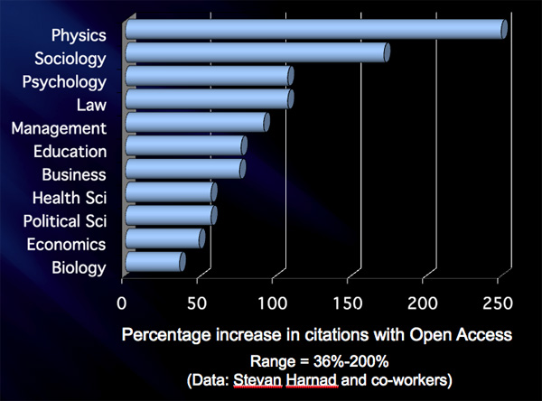
Green OA and
Citation Impact
Open access articles are viewed and cited more frequently than non-open access articles
Download advantage
Competitive advantage
Accessibility advantage
Source: Brody & Harnad (2004). “Comparing the Impact of Open Access (OA) vs. Non-OA Articles in the Same Journals.” D-Lib Magazine, 10(4), Available at http://www.dlib.org/dlib/june04/harnad/06harnad.html

Slide 8
Does OA Literature Make It
Into Systematic Reviews?
Yes
Citations in indexed journals make it into major citation databases like CINAHL, PubMed, Web of Science, Scopus and EMBASE.
Depositing work in Digital Commons does not require that you publish in a gold OA journal.

Slide 9
Impact Factors and OA
Impact factors favor journal-level metrics, disfavor Green OA distribution model
Budapest Open Access Initiative:
We discourage the use of journal impact factors as surrogates for the quality of journals, articles, or authors… Insofar as universities, funding agencies, and research assessment programs need to measure the impact of individual articles, they should use article-level metrics
http://soros.org/openaccess/boai-10-recommendations

Slide 10
OA or Impact Factor?
OA and impact factor!
By depositing your manuscripts in the Digital Commons, you can make the work freely accessible and available in full-text.
Depositing work in Digital Commons does not require that you publish in a gold OA journal.

Slide 11
Who benefits from OA?
Authors
Researchers
Teachers/Students
Libraries
Journals/Publishers
Governments/Funding Agencies
Notes:
Who Benefits from OA?
Authors:
Larger audience than a subscription journal
Increases visibility and impact of work
Readers/Researchers:
Barrier-free access to research, much of which they paid for with their tax dollars
Teachers/Students:
Democratizes access to resources, pulling down class inequalities
Libraries:
OA solves the scholarly communication pricing crisis (since 1989, prices for US society journals have increased at roughly twice the inflation rate annually.) (http://allenpress.com/resources/education/jps)
Journals and Publishers
OA makes their articles more visible, discoverable, retrievable, and useful
Which attracts submissions, advertising, readers and citations
Governments / Funding Agencies
OA increases the return on their investment in research, making the results of the funded research more widely available, more discoverable, more retrievable, and more useful

Slide 12
Why is it important
to make your work OA?
Higher citation counts for your research.
Nursing research has practical use- let others access to incorporate into practice.
Healthcare equity: http://www.righttoresearch.org/blog/6-reasons-open-access-matters-to-the-medical-commu.shtml
Education - Patient Care – Innovation – Patients’ Rights – Global Health Equity

Slide 13
Where to find
OA Nursing Literature
Directory of Open Access Journals
PubMed Central
BMC Nursing
OpenDOAR
OAIster
Google Scholar

Slide 14
What is Copyright?
A set of laws designed to give creators a package of rights over their original works of authorship
Create a derivative work or translations
Reproduce the work in copies
Distribute copies
Perform or display publically and digitally
Authorize others to exercise any of these rights
Notes:
Copyright automatically affixes to any work set down in a physical format.
Protects and balances the rights of author and public
Provides a legal framework that identifies creative work as unique, intellectual property with commercial value
Affects one’s ability to capitalize on the product of one’s own intellect
Provides a legal framework to recuperate damages in cases of infringement
Provides an outline of acceptable methods of using protected works for many purposes

Slide 15
TA and Copyright
Copyrights can be bought, sold, willed to others, or given away.
A transfer of the copyright or an exclusive grant or license to use the work is a transaction that must be conveyed in writing.
Notes:
TA == Toll access
This is how publishers legally operate.
Typical TA PUBLICATION SCENARIO:
Author(s) wrote article – upon creation, own copyright
Article accepted to be published
Author wants widest possible distribution & impact
Place a copy in Digital Commons or personal webpage
Post to Blackboard Course
E-mail to Colleagues
Re-use section in a new article
In order to publish you are required to sign a rights transfer with the publisher, generally signing over your copyright.

Slide 16
Author’s Rights
after Publication
If you sign over your copyright you are technically required to ask for permission to use your own work:
To post on your website
To contribute to a repository
To digitally archive your own work
To share with others
To allow others to use your work

Slide 17
OA and Copyright
OA publishing approaches copyright issues under the same two approaches as TA publishing:
Public domain
Permission of the rightsholder
http://www.arl.org/sparc/publications/oanewsletter-oa-and-copyright.shtml
Notes:
Authors of new work are the copyright holders until or unless they transfer copyright to someone else, like a publisher. Publishers only hold the rights that authors voluntarily transfer to them.
the best strategy:
to keep the key rights in the hands of authors, or
(2) to transfer rights to OA publishers rather than TA publishers, or
(3) to obtain permission from authors *before* they transfer rights to TA publishers.

Slide 18
American Sociological
Review, ASA
“So that you as Author and we as Publishers may be protected from the consequences of unauthorized use of its contents, as a condition of publication it is essential that you grant us the copyright to your contribution. To this end we ask you to grant us all rights, including subsidiary rights, to your article. However, as specified below, you retain the right to use your article without charge in any book of which you are the sole author or editor after it has appeared in an ASA journal.”
“The Author transfers and assigns to the ASA for the full term of copyright as may now or hereafter exist, all rights, title and interest, including copyright, including but not limited to the sole and exclusive right to print, publish, license and otherwise sell your work in whole or in part in all media in all languages and all editions throughout the world and the exclusive rights to license or exercise throughout the world all subsidiary rights, including electronic formats, whether now in existence or hereafter invented.”
“The American Sociological Association, in turn, grants to Authors the right of republication in any print edition of which they are the sole author or editor, subject only to their giving proper credit in the book to the original publication of the article by the ASA.”
“Moreover, the Author may provide the final accepted manuscript post-print to an online university or other institutional repository (including that required by a supporting grant). However, public availability must be delayed until 12 months after its print publication by ASA.”
PDF available at:
http://www.sherpa.ac.uk/romeo/search.php?id=18
Notes:
Author Agreement
ASA:
The Author transfers and assigns to the ASA for the full term of copyright as may now or hereafter exist, all rights, title and interest, including copyright, including but not limited to the sole and exclusive right to print, publish, license and otherwise sell your work in whole or in part in all media in all languages and all editions throughout the world and the exclusive rights to license or exercise throughout the world all subsidiary rights, including electronic formats, whether now in existence or hereafter invented.”
ASA, in turn, grants to Authors the right of republication in any print edition of which they are the sole author or editor, subject only to their giving proper credit in the book to the original publication of the article by the ASA.”
Moreover, the Author may provide the final accepted manuscript post-print to an online university or other institutional repository (including that required by a supporting grant). However, public availability must be delayed until 12 months after its print publication by ASA.”

Slide 19
Blood, Am. Soc.
of Hematology
I. COPYRIGHT TRANSFER AGREEMENT
Section A
The authors hereby transfer all copyrights in and to the manuscript named above (called the Work hereafter) in all forms and media, now or hereafter known, to the American Society of Hematology (ASH) effective if and when the Work is accepted for publication in Blood, Journal of The American Society of Hematology.
The authors retain the following non-exclusive copyrights, to be exercised only after the Work has been published in final format in the print version of Blood.
(a) Reprint the Work in print collections of the author’s own writing.
(b) Present the Work orally in its entirety.
(c) Use the work in theses and/or dissertations.
(d) Reproduce the Work for use in courses the author is teaching. (If the author is employed by an academic institution, that institution may also reproduce the Work for course teaching.)
(e) Distribute photocopies of the Work to colleagues, but only for non-commercial purposes.
(f) Reuse figures and tables created by the author in future works the author writes.
(g) Post a copy of the Work on the author’s personal website, departmental website, and/or the university’s intranet, provided a hyperlink to the Work on the Blood website is included.
PDF available at:
http://bloodjournal.hematologylibrary.org/forms/copyright_transfer.dtl
Notes:
Author Agreement
ASoH: The authors hereby transfer all copyrights in and to the manuscript named above (called the Work hereafter) in all forms and media, now or hereafter known, to the American Society of Hematology (ASH)
The authors retain the following non-exclusive copyrights
Post a copy of the Work on the author’s personal website, departmental website, and/or the university’s intranet, provided a hyperlink to the Work on the Blood website is included.

Slide 20
Author Addendum
Using an addendum, author can unbundle these rights and transfer only some to them to publishers
Delayed Access
Access/Re-use
Immediate Access
http://guides.lib.wayne.edu/scholarlycomm/
Notes:
In cases where OA permissions aren’t explicit in the publishing contract
Delayed (ASA, ie.)
Freely accessible versions
Author Version posted immediately
Publisher Version posted 6 months after publication
Immediate
Publisher version freely accessible upon publication
MIT uses this for Faculty Open Access Mandate compliance
Access/Re-Use
Publisher version freely accessible upon publication
Gives work a Creative Commons license, sharing your distribution rights. Public can also re-use/post so long as you are:
Given credit as author
Reader’s use is non-commercial
We have an addendum generator at LibGuide

Slide 21
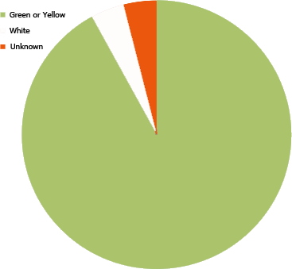
Green OA and
Nursing Journals
Analysis of top 25 nursing journals in JCR shows that 23/25 allow for self-archiving.
Notable exception: Oncology Nursing Society does not allow self-archiving without prior permission.
Check Sherpa/Romeo for publisher policy.

Slide 22
Green OA at Wayne State
DigitalCommons@Wayne State: http://digitalcommons.wayne.edu
an open access scholarly publishing service available to WSU faculty, staff, and students;
a permanent archive for WSU research and scholarly output, providing perpetual access to materials as broadly as possible.
Notes:
Funded and supported by the Library System since 2005
We want to publish WSU and WSU-affiliated:
Published articles (post-prints)
Presentations, talks, unpublished manuscripts, working papers
Datasets and other supplemental materials
Paper/seminar series
Conference proceedings
Out-of-print books
Teaching materials
Research, scholarship, or creative activity of any kind
Journals
Conferences + Events

Slide 23
Green OA at Wayne State
DigitalCommons…
Receives and archives one electronic copy
Preserves this copy permanently
Creates a short and stable URL with a wayne.edu address
Notes:
We want to publish WSU and WSU-affiliated:
Published articles (post-prints)
Presentations, talks, unpublished manuscripts, working papers
Datasets and other supplemental materials
Paper/seminar series
Conference proceedings
Out-of-print books
Teaching materials
Research, scholarship, or creative activity of any kind
Journals
Conferences + Events

Slide 24
Green OA at Wayne State
Track interest with monthly readership reports automatically sent to your e-mail for each article deposited in DigitalCommons
Metrics:
124,836 Full-text downloads since inception
Over half of those in the past year (73K)
Notes:
Number of Downloads automatic. Hits available on request.

Slide 25
Green OA at Wayne State
Accessible immediately, worldwide
Identified with author’s name, date of submission, original citation
Collected together in one place
Allows wider distribution of scholarly work (outside typical author’s network)
Notes:
What’s in it for me?
Retention of copyright
Increased citation rates
Google search optimization
Perpetual access & preservation
Comprehensive usage data
Free setup, training & support

Slide 26
Green OA at Wayne State
67% of traffic comes from Google and Google Scholar
Full-text indexed by search engines
BePress actively works with Search Engine companies to revise and improve discoverability
Library Digital Publishing takes care of the rest
Harvested by worldwide library catalogs
Notes:
Digital Commons supports the Open Archives Initiative Protocol for Metadata Harvesting (OAI-PMH) 2.0

Slide 27
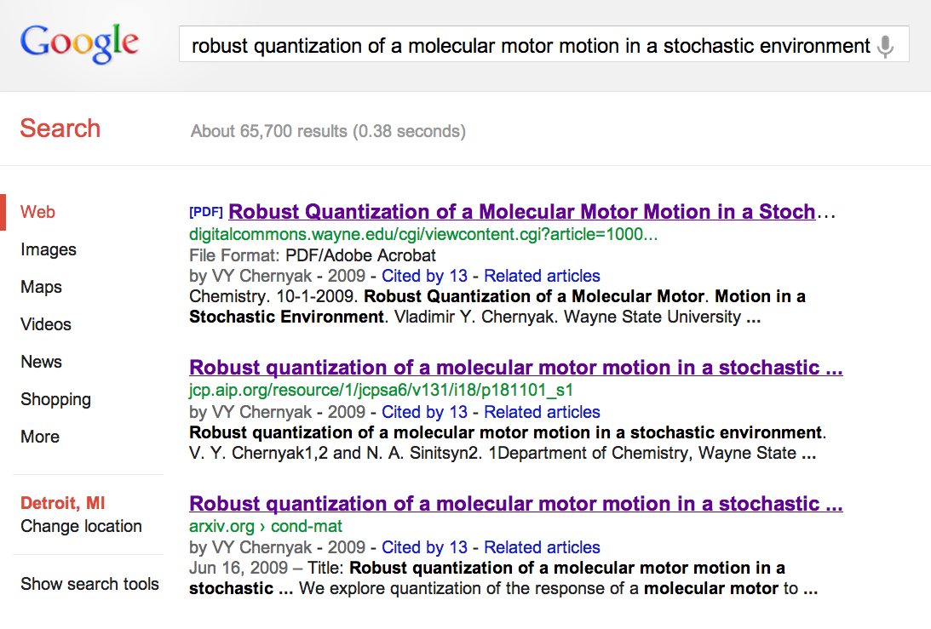
Green OA at Wayne State

Slide 28
Green OA at Wayne State
Who controls copyright in DigitalCommons?
The author/creator or the party to whom copyright has been sold or licensed by the author.
Not the library; not the university; not BePress

Slide 29
Finding Journals with
Author-Friendly Policies
http://www.sherpa.ac.uk/romeo
Notes:
So, you need to identify which of your prior publications (or future publications) are friendly to Green OA .

Slide 30
Getting Started: DIY
Find an existing series (Nursing Faculty Research Publications, for example)
Login, or register
Begin to upload your own Word/PDF files
Abstract
Keywords
Citation Information (if already published)
PDF/.doc copy of article/chapter
Additional files, if desired (datasets, images)
Notes:
Do It Yourself

Slide 31
Getting Started: DIFM
E-mail me your/another’s vita or list of publications.
There is no second step.
jnf@wayne.edu or
digitalcommons@wayne.edu
Notes:
Do It For Me

Slide 32
Questions
Alexandra Sarkozy
Liaison, College of Nursing
ff2662@wayne.edu
Joshua Neds-Fox
Coordinator for Digital Publishing
jnf@wayne.edu | 7-4460 | 172 Purdy Library

